Slide 1
R workshop
Sunghoon Kim
(I will introduce myself at the first class of Marketing Analytics)

Slide 2
Workshop Objectives
Introduce R.
What is R? Why R?
How to run basic and useful commands.
It’s boring to learn any software itself! So, I’ll try to use many relevant business examples.
Also, let’s review some fundamental, relevant statistics with R!
I will help you practice R in this workshop!
I will do minimum lecture and demonstrate some examples first (50% of class time)…
Then, I will give you practice problems and time (50% of class time).
As my guess, there are some variances for R skills (familiarity) between students. So, let’s build teams (3 or 4 people). You discuss the practice problems within team, which will be helpful.

Slide 3
Workshop Agenda
Workshop Session (A): R Introduction
Workshop Session (B): Data Processing
Workshop Session (C): Fundamental Business Statistics with R
Probability & Distributions, Descriptive Statistics, Plots & Graphics with R
Workshop Session (D): Basic Business Statistics with R
Confidence Intervals, Mean Comparison Hypothesis Testings

Slide 4

(A) Introduction

Slide 5
Introduction of Software
R is a free software for statistical computing and graphs supported by the R foundation for statistical computing and data analytics and also is used as a programming language. The R language is widely used among statistician and data scientists for developing statistical solutions.
R is used by many companies such as Google, IBM, MicroSoft, and many other companies.
R has a HUGE users community – please search any problem from online community! We cannot memorize solutions… and so I do this every time.

Slide 6
Introduction of Software
R is an interpreted language with a command-line interpreter. (We don’t need compiler)
It helps to understand what is going on in our analysis (vs. compared with user-friendly software such as SPSS, SAS)
We can reuse the commands for a certain type of analysis; I strongly recommend your R analysis library with your own comments!

Slide 7
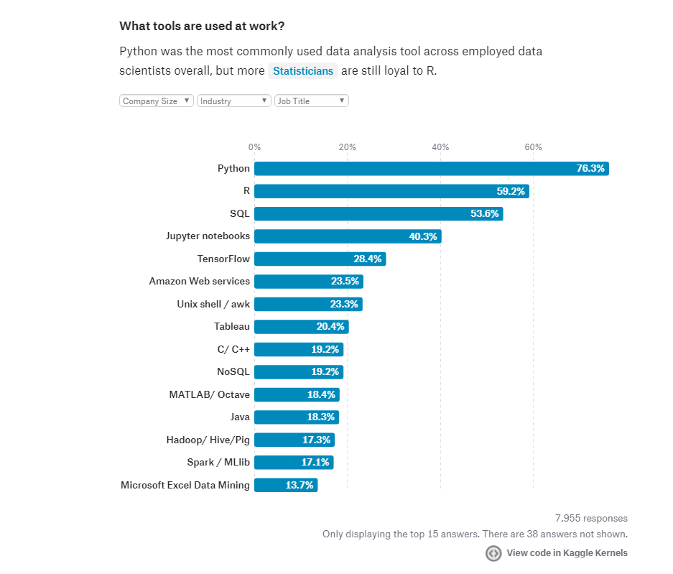
As I know, R was not originally developed as a programming language but originally it has been developed as a statistical analytics. But, it is recently growing as a language as well… You will experience why R is convenient for many kinds of statistical analysis.
In my opinion, R and Python are complimentary these days.

Slide 8
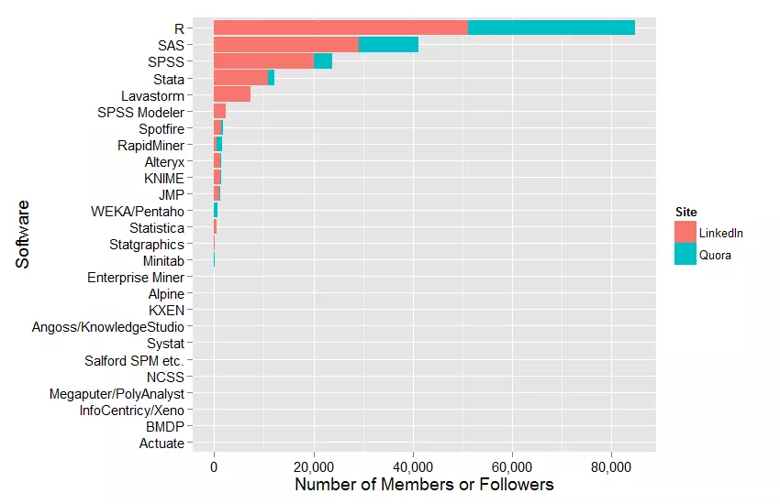
Discussions Forum Activity (LinkedIn and Quora) for Statistical Analysis, 10/17/2015
Large community is helpful for your learning!
(Some general purpose languages like JAVA, Matlab, C or Python are not included.)
from r4stats.com/articles/popularity

Slide 9
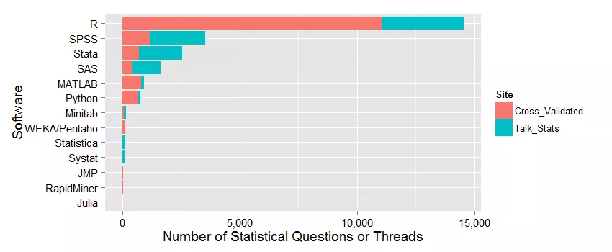
Statistical Discussions Forum Activity (Cross_Validated, Talk_Stats) on 10/17/2015
Large community is helpful for your learning!
from r4stats.com/articles/popularity

Slide 10
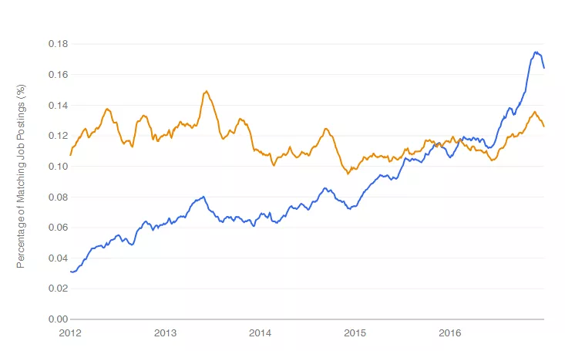
Number of analytics jobs available for R Compared with SAS
R (Blue); SAS (Orange), from r4stats.com/articles/popularity
I think SAS is a powerful tool…
Notes:
Python and R are, of course, very different languages and a quick scan of job descriptions will show that the R jobs are much more focused on the use of existing methods of analysis (it’s also possible for programming though), while the Python jobs have more of a custom-programming angle to them.

Slide 11
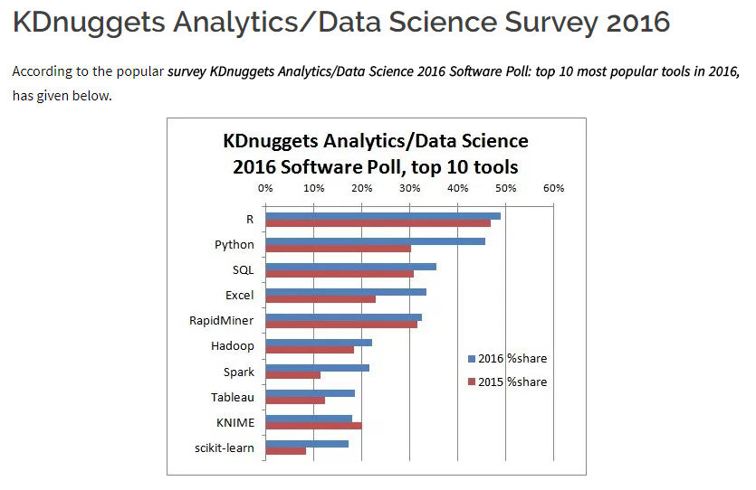
What programming languages you used for data mining /data analysis in the past 12 months? (by KDnuggets)
Notes:
Python and R are, of course, very different languages and a quick scan of job descriptions will show that the R jobs are much more focused on the use of existing methods of analysis (it’s also possible for programming though), while the Python jobs have more of a custom-programming angle to them.

Slide 12
So, which software we have to use?
It depends on which software your employer or boss will be mainly using… ☺
So, you have to be prepared for both and others!
R, Python and other software can be complimentary each other…
If you have proficiency with R, you can easily learn other software…

Slide 13
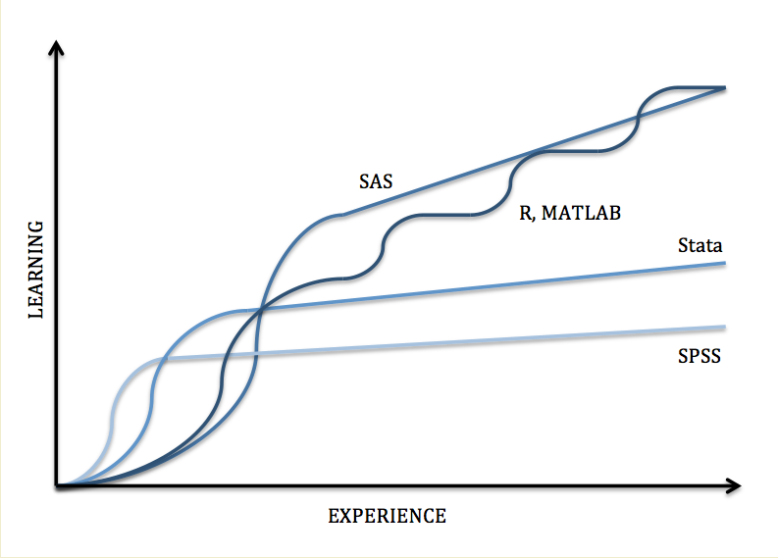
Learning Curve Comparison
We need some patience and efforts at the beginning…

Slide 14
Now, let’s install R
Download from: http://cran.us.r-project.org/
For R Studio, https://www.rstudio.com/products/rstudio/
Given all comments and functionality are same, I will use R for class lecture...

Slide 15
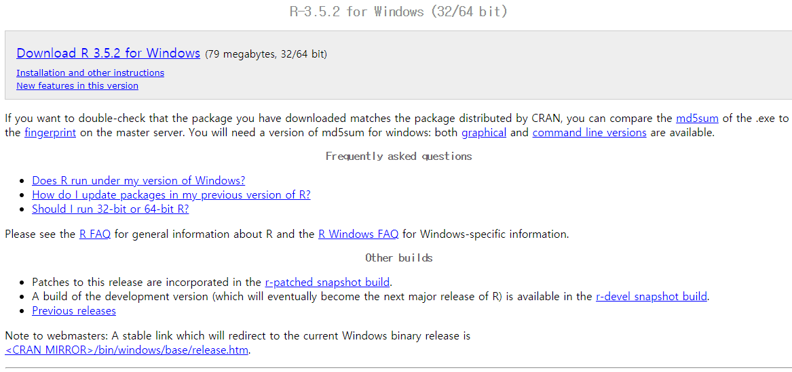
R instillation
www.r-project.org → click “download R” → choose any link (e.g., https://cran.cnr.Berkeley.edu/ here) → we will move to https://cran.cnr.berkeley.edu/ → click “Download R for Windows” here (you may choose other OS such as Linux or Mac). → click “install R for the first time” → click “Download R 3.5.2 for Windows” (see the screen shot below)
Rstudio is also available for Windows, Mac OS X and Linux at http://www.rstudio.com.

Slide 16
Now, you have “R” (or “R studio”)
Let’s run and open R…
I am mainly using “R Editor” Window and run the comments from “Editor” to “R Console” window.
From Editor, I strongly recommend you to save your comments into txt file with your own R folders.
Also, you can add your own comments with “#”. This help you remind what you did with R when you reuse your R script.
E.g., # regression analysis; ## Combining columns;
## https://blog.rstudio.com/2018/09/12/getting-started-with-deep-learning-in-r/

Slide 17

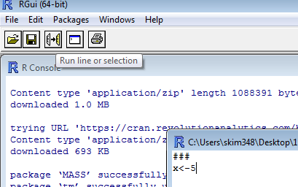
Let’s start R
You can directly work in console window but I prefer to work in script window, because we can save the script history for future R programming:
go to save (or save as) → select directory → write file name and click save.
As an alternative, you can “copy and paste” all commands in a text file.
The selected R commands can be executed by using
or “ + R”
For R studio, click “Run” icon or “Ctrl + Enter”.

Slide 18
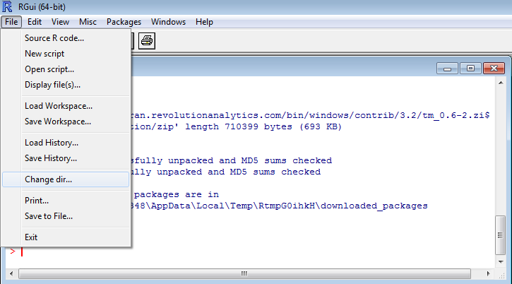
Change working directory
Use R command: setwd, E.g., setwd("D:/ASU_Marketing/");
Or,

Slide 19
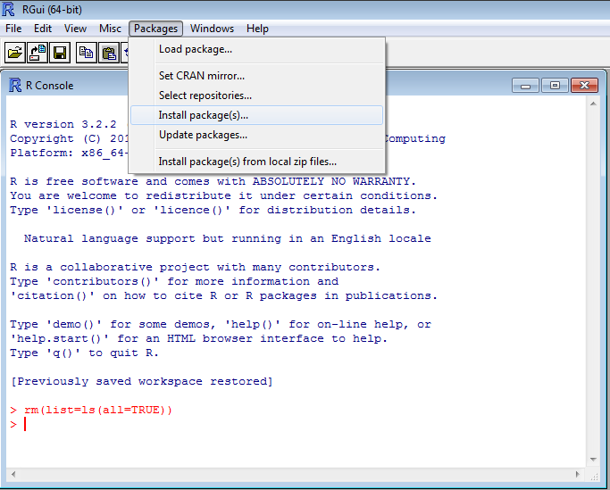
Install Packages (with R)
Frist, you decided which method you will use for your problem.
Then, please search the analytics method in Internet (e.g., Google): for example, Probit Regression in R package → find the “package name” of the method.
Then, you can install any package using: install.packages(c("MASS","tm"))
As alternative, please go to “Packages” → “Install Package(s)” → Choose any link (e.g., USA (CA1)) → Select any package you want to install → call the installed package using command “library (MASS)”.

Slide 20
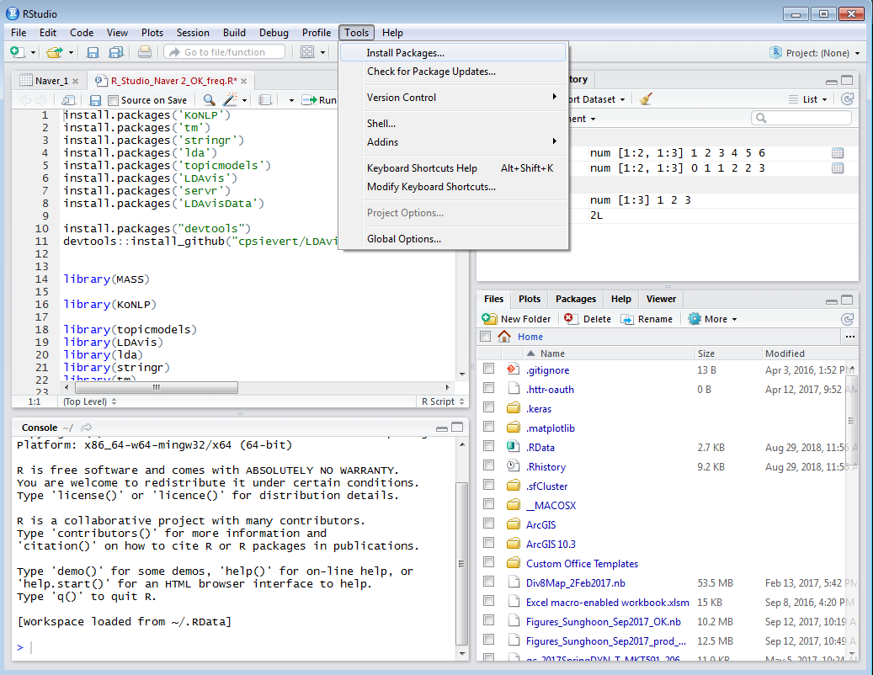
Install Packages (with RStudio)

Slide 21
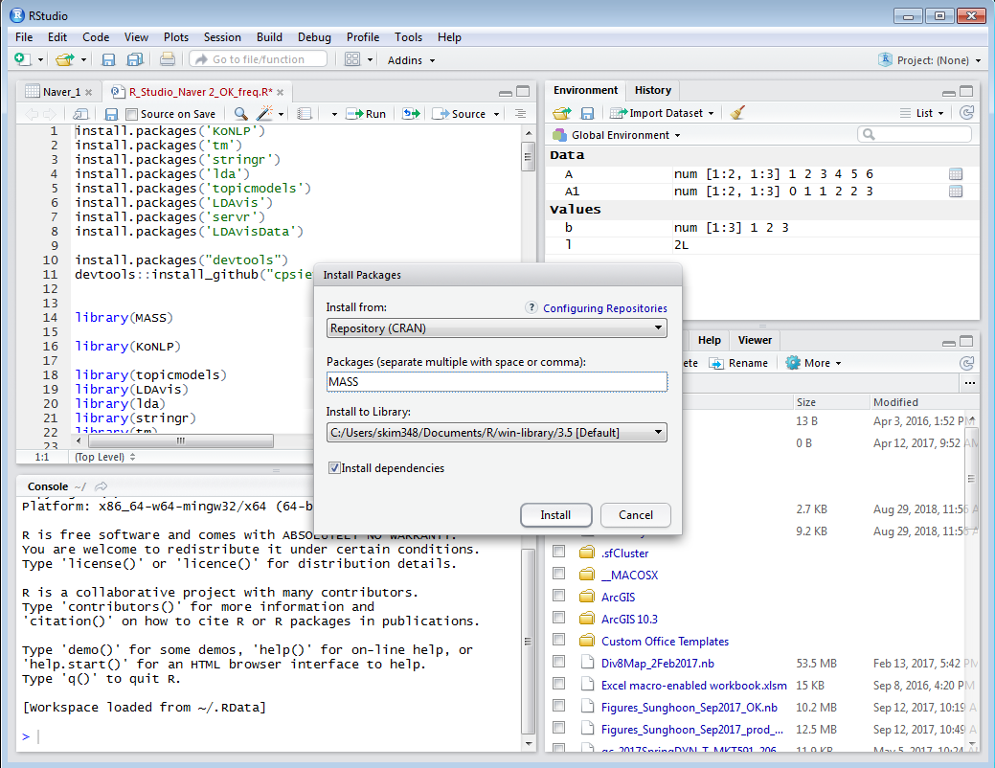

Slide 22
Suggested Steps for using
Identify your problem (i.e., managerial problem & technical problem).
Decide analytics method (e.g., CrossTab or Regression?) you need to try.
If you don’t remember, please searching references (e.g., Internet, textbook) and find relevant commands in R.
Usually, example commands is very helpful! (Follow it…)
Notes:1) Nobody memorizes all R commands. 2) There are no one way for any R commands.
Running and interpreting the results by R.
Apply the results to solve your business problem.
My suggestions: Build your own R codes library during this class: Save any R codes you’ve used with procedure titles for future use (keep adding new useful codes and reuse it for new data).
I will explain details more later, when we use and practice R

Slide 23
In this session, from now…
We need to learn basic things in R…
Let’s start with useful objects and operations in R first…

Slide 24
Topic 1 in Workshop (A): Vector
Scalar – Vector – Matrix – Array (Way to handle data in R)
Let’s briefly see single scalers (e.g., 3+5).
R is case sensitive and so “x” and “X” are different objects.
Next, create Vectors.
Some useful commands for generating Vectors.
Vector computations: element-wise computation.

Slide 25
Practice: Vector (1)
Create vectors with second half sales of 2019:
150, 200, 250, 160, 110, and 220.
2. Now, let’s get a vector for sales of 2019 and get a vector of total sales of 2019

Slide 26
Practice: Vector (2)
Using seq(), generate a vector of sequence numbers: 2, 5, 8, 11
Generate a vector of sequential numbers from 1 to 15000 by 3, what is 100th number of this vector?

Slide 27
Topic 2 in Workshop (A): Random Number of generations
Let’s generate integer numbers.
Searching certain number(s) from the generated vector.
Certain position (e.g., 10th or 20th), Max/Min

Slide 28
Practice: Random Number of generations
1. Generate 1000 numbers from 1 to 100. with the set.seed(100) number. What is the last number?

Slide 29
Topic 3 in Workshop (A): Check object types
Numeric, Factor, Logical or Character?
Mostly, we will analyze numeric or factor. But, we have to understand other types of object.

Slide 30
Practice: Topic 3 in Workshop (A): Check object types
Create a vector with a number (e.g., 100) and character "Arizona“.
Check this object is numeric or character.
Is this numeric? Or character?

Slide 31
Topic 4 in Workshop (A): Working with Matrix
If anyone is not familiar with matrix, I recommend you to study “linear algebra” or “matrix algebra” using online materials or book.
Build matrix.
Generate matrix.
Matrix Indexing: E.g., how to select a value in 10th row and 5th column?
Combining Matrices by columns or by rows
Matrix Operations

Slide 32
Practice: Topic 4 in Workshop (A): Working with Matrix
Create a vector "C" with: 71 3 84 89 88 12 50 38 1 55.
Create another vector "D" with: 20 97 53 54 36 29 29 44 40 28.
Conduct matrix multiplication with two (10 X 1) matrices.
Generate a (10 X 10) matrix “E” of sequential numbers from 1 to 100.
Conduct matrix multiplication (i.e., use %*%) E by C. What will be output dimension?
Conduct matrix multiplication C by E. What will be output dimension?

Slide 33
Topic 5 in Workshop (A): Introducing Array
High-dimensional matrices (e.g., multiple sets of matrices)
Sometimes useful to handling multisets of data and useful for programming.

Slide 34
Topic 6 in Workshop (A): (For) Looping, if else statement.
Basically, we mainly use “for” looping and “while” looping. I will cover “for” looping in this workshop. If you understand “for” looping, it is not difficult to use “while” looping.
At the beginning, please think “what is going on inside of looping”… Later, you will be familiar with it.
Let’s see R class examples.

Slide 35
Practice: Topic 6 in Workshop (A): (For) Looping, if else statement.
Make a R code for following (hint use for looping and if-else commands)
Generate a integer number of 1 and 0 with probability 0.2 and 0.8 100 times (hint: use "sample" function for this). Then, if the generated number is 1, you can win $1000, otherwise you lose $300. With 100 trials, what is your expected return (i.e., money) you can get...

Slide 36
Topic 7: Useful ‘apply’ function feature
This is useful for reduce the lines of R code. Good to know… I will show some examples.
‘lapply’ – it’s useful for handling list
‘apply’ – it’s useful for matrix computation programming

Slide 37
Topic 8: Measure time for R
Sometimes, computing time is important to modelers!
For developing any function, you might be interested in computation efficiency
‘system.time()’
user (time): time charged to the CPU(s) for this expression
elapsed (time): “wall clock” time
Usually user time and elapsed time are similar…

Slide 38
Topic 9 in Workshop (A): function in R
It is useful to reuse your programmed scripts with input data and outputs.
Once you save your function as a separate file, you can easily import and use it.
Let’s see the example…

Slide 39
Session Ending Practice!
Work this practice as a team. Once any team makes correct answer, please come to front and explain your coding and answer! I have a small prize (e.g., cookie ☺).
Use the two data sets of “car_prices” and “Car_discount_rate”, where you can find discounted rates for different types of cars.
Please compute discounted car prices for all cars...
(Hint 1) use for looping! First, your R code should search discount rate.
(Hint 2) for discounted price, you should multiply the price * (1-discount_rate), E.g., 15*(1-0.05),
Don't do this by your hand line by line...

